Slide 1





Exploratory Data Analysis (EDA) with Numpy & Pandas

Slide 2

Hello!
I am Eslam Ahmed
I am a software engineer.
You can find me at jeksogsa@gmail.com

Slide 3

Hello!
I am Eman Ehab
I am a ML research engineer.
You can find me at emanehab.ieee@gmail.com

Slide 4
Agenda
What is Numpy
Install and use Numpy
Create Numpy Array
Built in Methods
Reshaping
Indexing
Selection
Arithmetic and Logic
Universal Array Functions
Combine and split
What is Pandas
Series
Data Frames
Deal with Missing data
Grouping data and aggregate functions
Merging, Joining and Concatenating
Pivoting
Useful Methods
Apply function
Data Input & Output

Slide 5
Agenda
What is Numpy
Install and use Numpy
Create Numpy Array
Built in Methods
Reshaping
Indexing
Selection
Arithmetic and Logic
Universal Array Functions
Combine and split
What is Pandas
Series
Data Frames
Deal with Missing data
Grouping data and aggregate functions
Merging, Joining and Concatenating
Pivoting
Useful Methods
Apply function
Data Input & Output

Slide 6
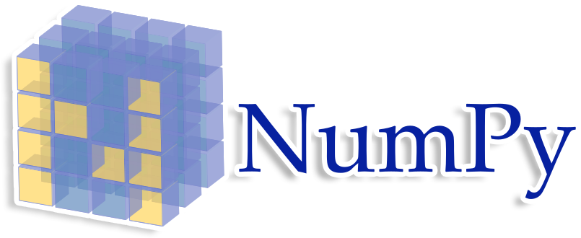
What is Numpy
NumPy is a Python package which stands for
'Numerical Python'. It is a library consisting of
multidimensional array objects and a collection
of routines for processing of array.
The most important object defined in NumPy is
an N-dimensional array type called ndarray

Slide 7
Agenda
What is Numpy
Install and use Numpy
Create Numpy Array
Built in Methods
Reshaping
Indexing
Selection
Arithmetic and Logic
Universal Array Functions
Combine and split
What is Pandas
Series
Data Frames
Deal with Missing data
Grouping data and aggregate functions
Merging, Joining and Concatenating
Pivoting
Useful Methods
Apply function
Data Input & Output

Slide 8
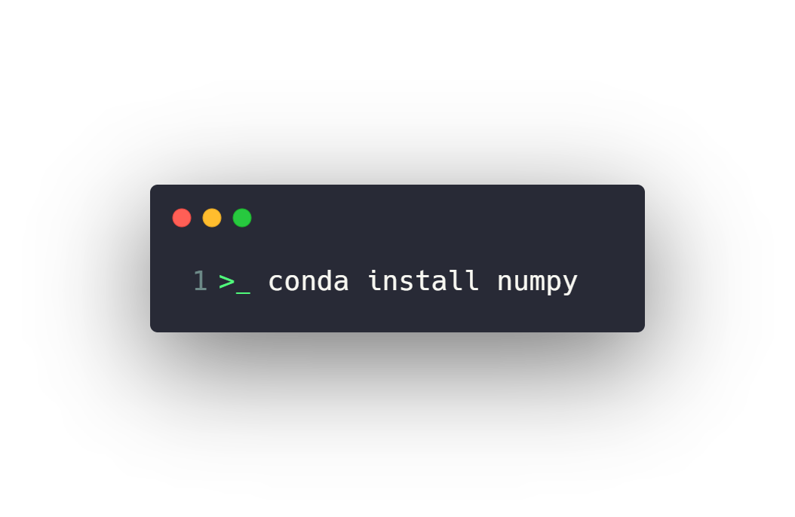


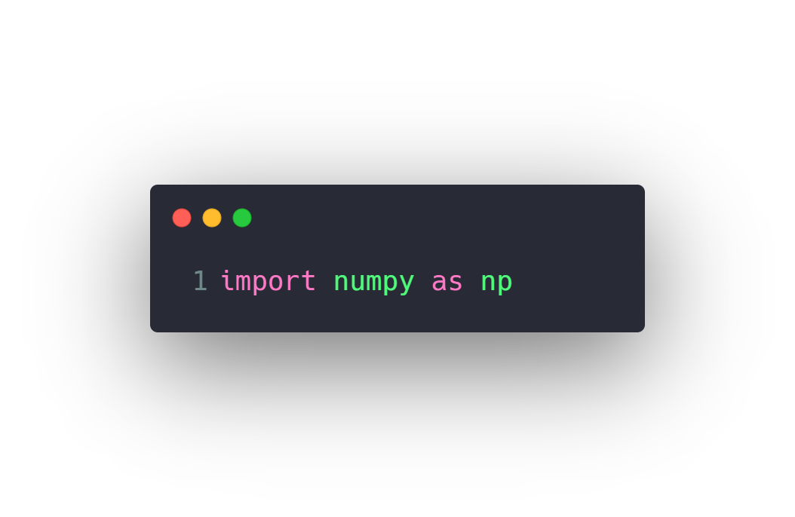

Install and use Numpy
Install
Use

Slide 9
Agenda
What is Numpy
Install and use Numpy
Create Numpy Array
Built in Methods
Reshaping
Indexing
Selection
Arithmetic and Logic
Universal Array Functions
Combine and split
What is Pandas
Series
Data Frames
Deal with Missing data
Grouping data and aggregate functions
Merging, Joining and Concatenating
Pivoting
Useful Methods
Apply function
Data Input & Output

Slide 10
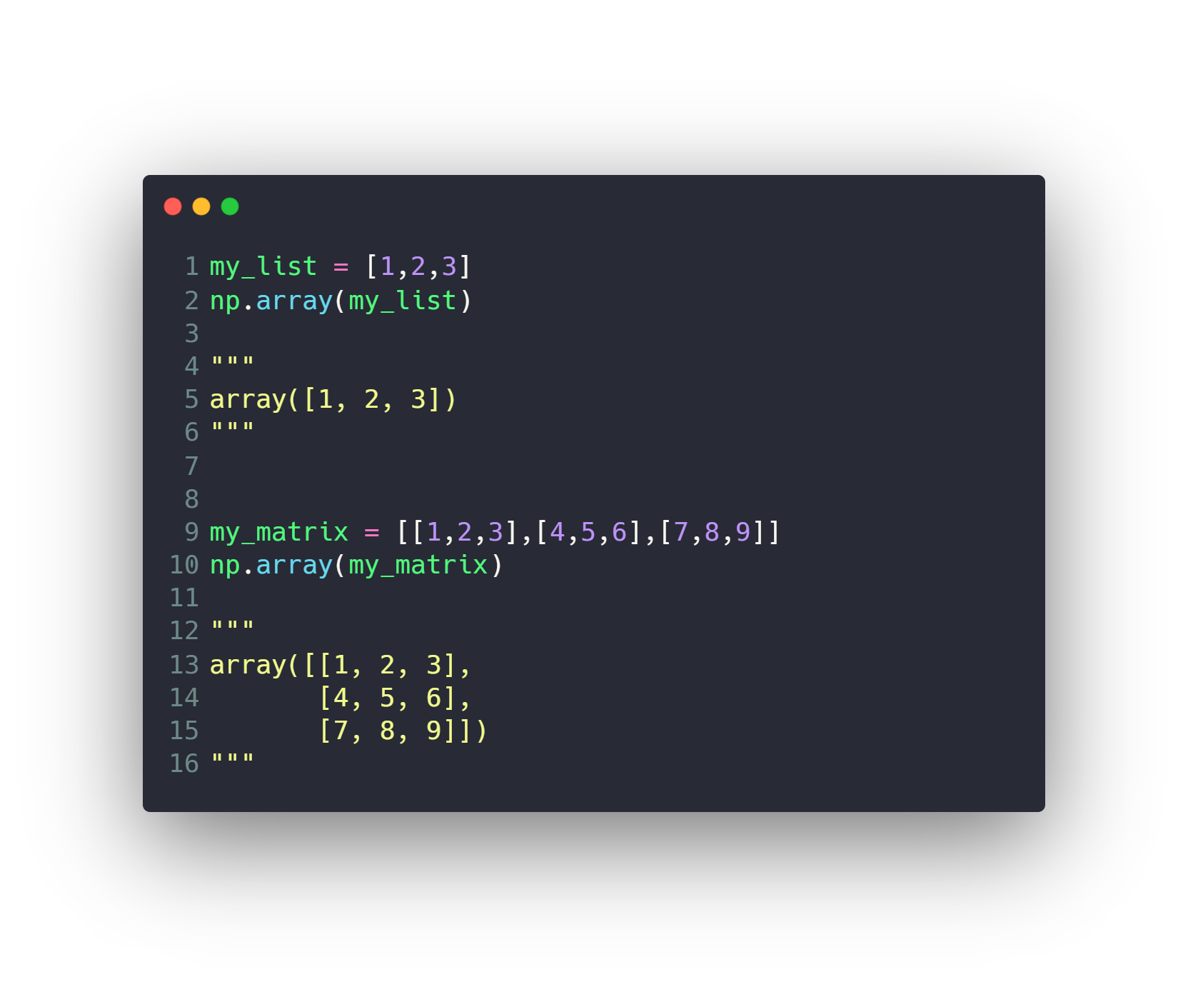
Create Numpy Array
Numpy arrays essentially come in two
Flavors vectors and matrices. Vectors are
strictly 1-d arrays and matrices are 2-d,
but you should note a matrix can still have
only one row or one column.

Slide 11
Agenda
What is Numpy
Install and use Numpy
Create Numpy Array
Built in Methods
Reshaping
Indexing
Selection
Arithmetic and Logic
Universal Array Functions
Combine and split
What is Pandas
Series
Data Frames
Deal with Missing data
Grouping data and aggregate functions
Merging, Joining and Concatenating
Pivoting
Useful Methods
Apply function
Data Input & Output

Slide 12
Built in Methods
arange
zeros
ones
eye
linspace
rand
randn
randint
max
argmax
min
argmin

Slide 13
Agenda
What is Numpy
Install and use Numpy
Create Numpy Array
Built in Methods
Reshaping
Indexing
Selection
Arithmetic and Logic
Universal Array Functions
Combine and split
What is Pandas
Series
Data Frames
Deal with Missing data
Grouping data and aggregate functions
Merging, Joining and Concatenating
Pivoting
Useful Methods
Apply function
Data Input & Output

Slide 14
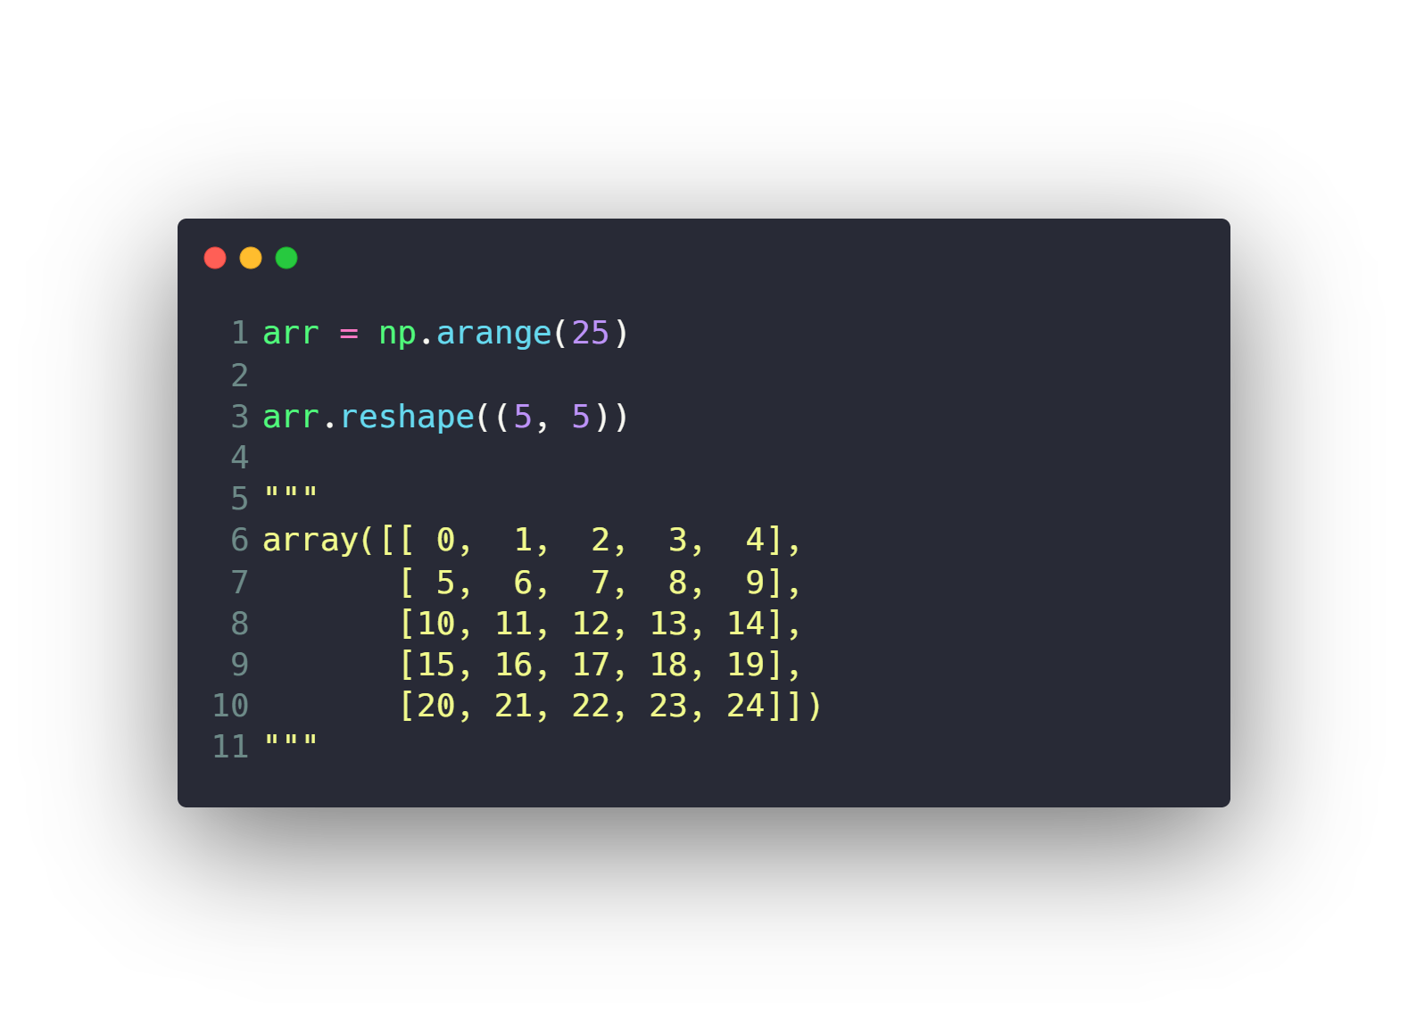
Reshaping

Slide 15
Agenda
What is Numpy
Install and use Numpy
Create Numpy Array
Built in Methods
Reshaping
Indexing
Selection
Arithmetic and Logic
Universal Array Functions
Combine and split
What is Pandas
Series
Data Frames
Deal with Missing data
Grouping data and aggregate functions
Merging, Joining and Concatenating
Pivoting
Useful Methods
Apply function
Data Input & Output

Slide 16
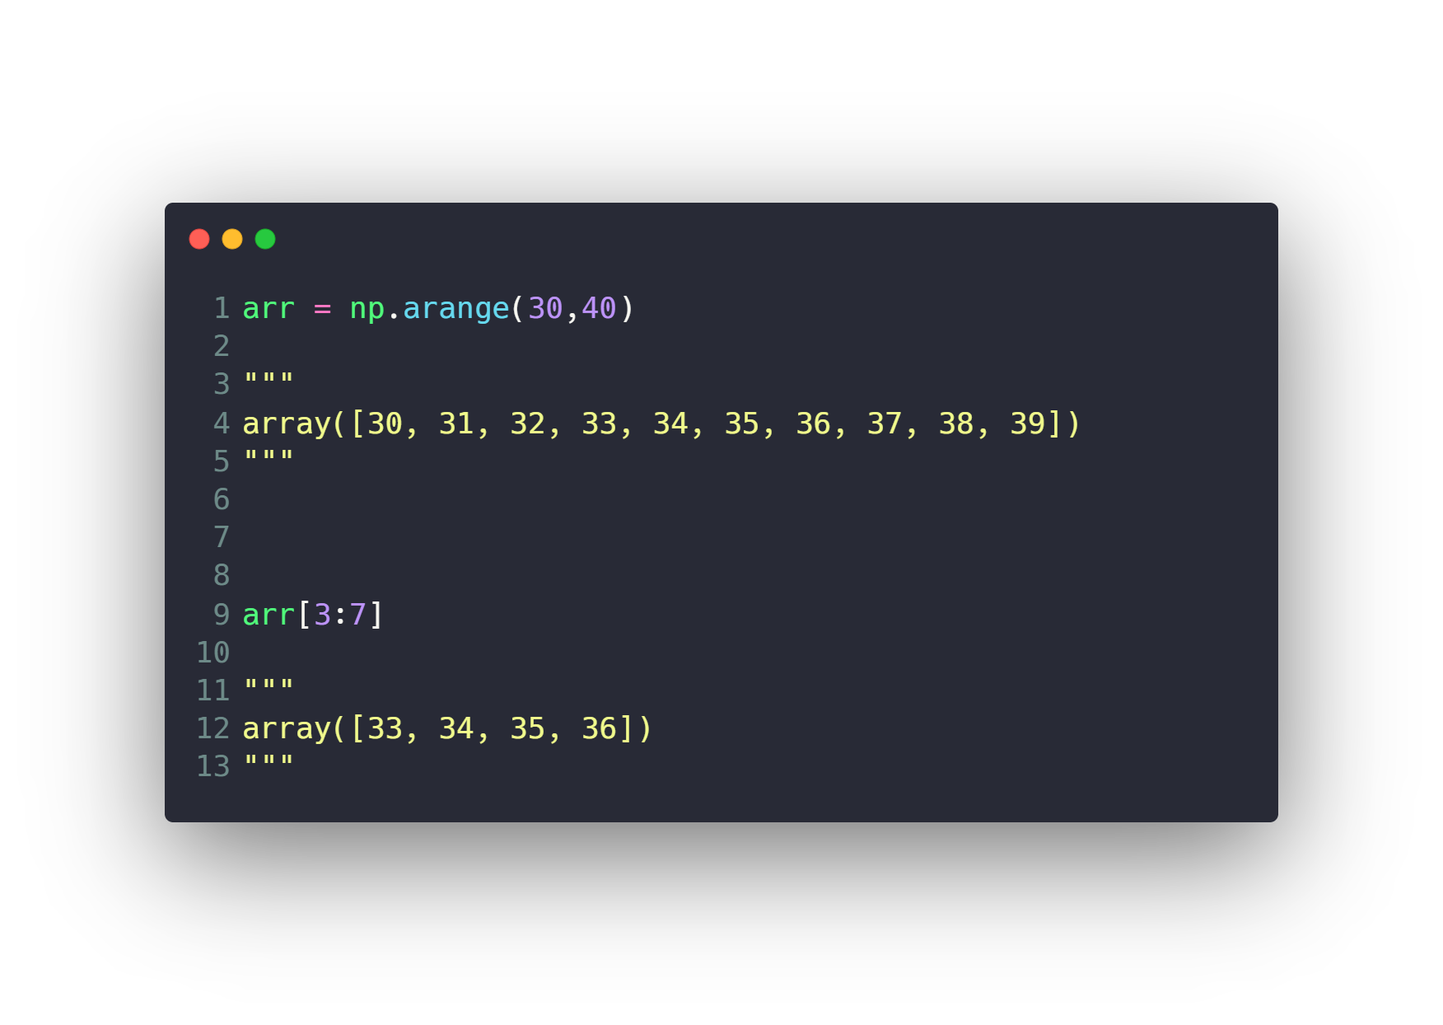
Indexing
Indexing 1D array
Indexing 2D array
Fancy Indexing

Slide 17
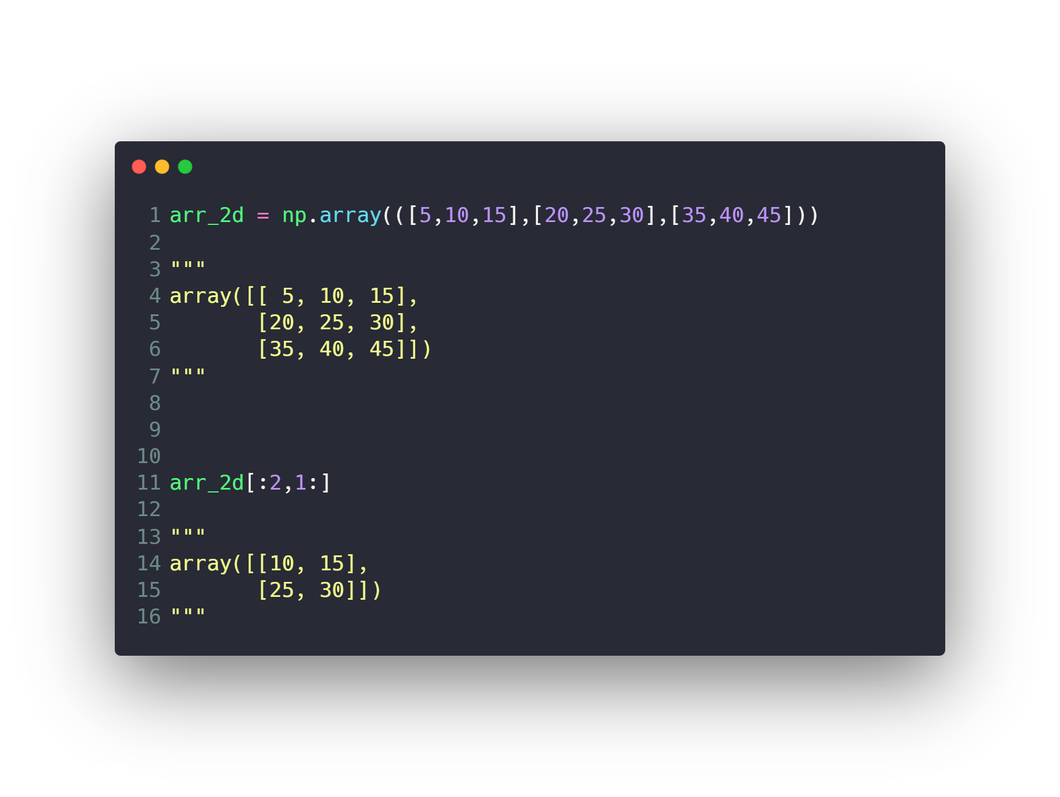
Indexing
Indexing 1D array
Indexing 2D array
Fancy Indexing

Slide 18
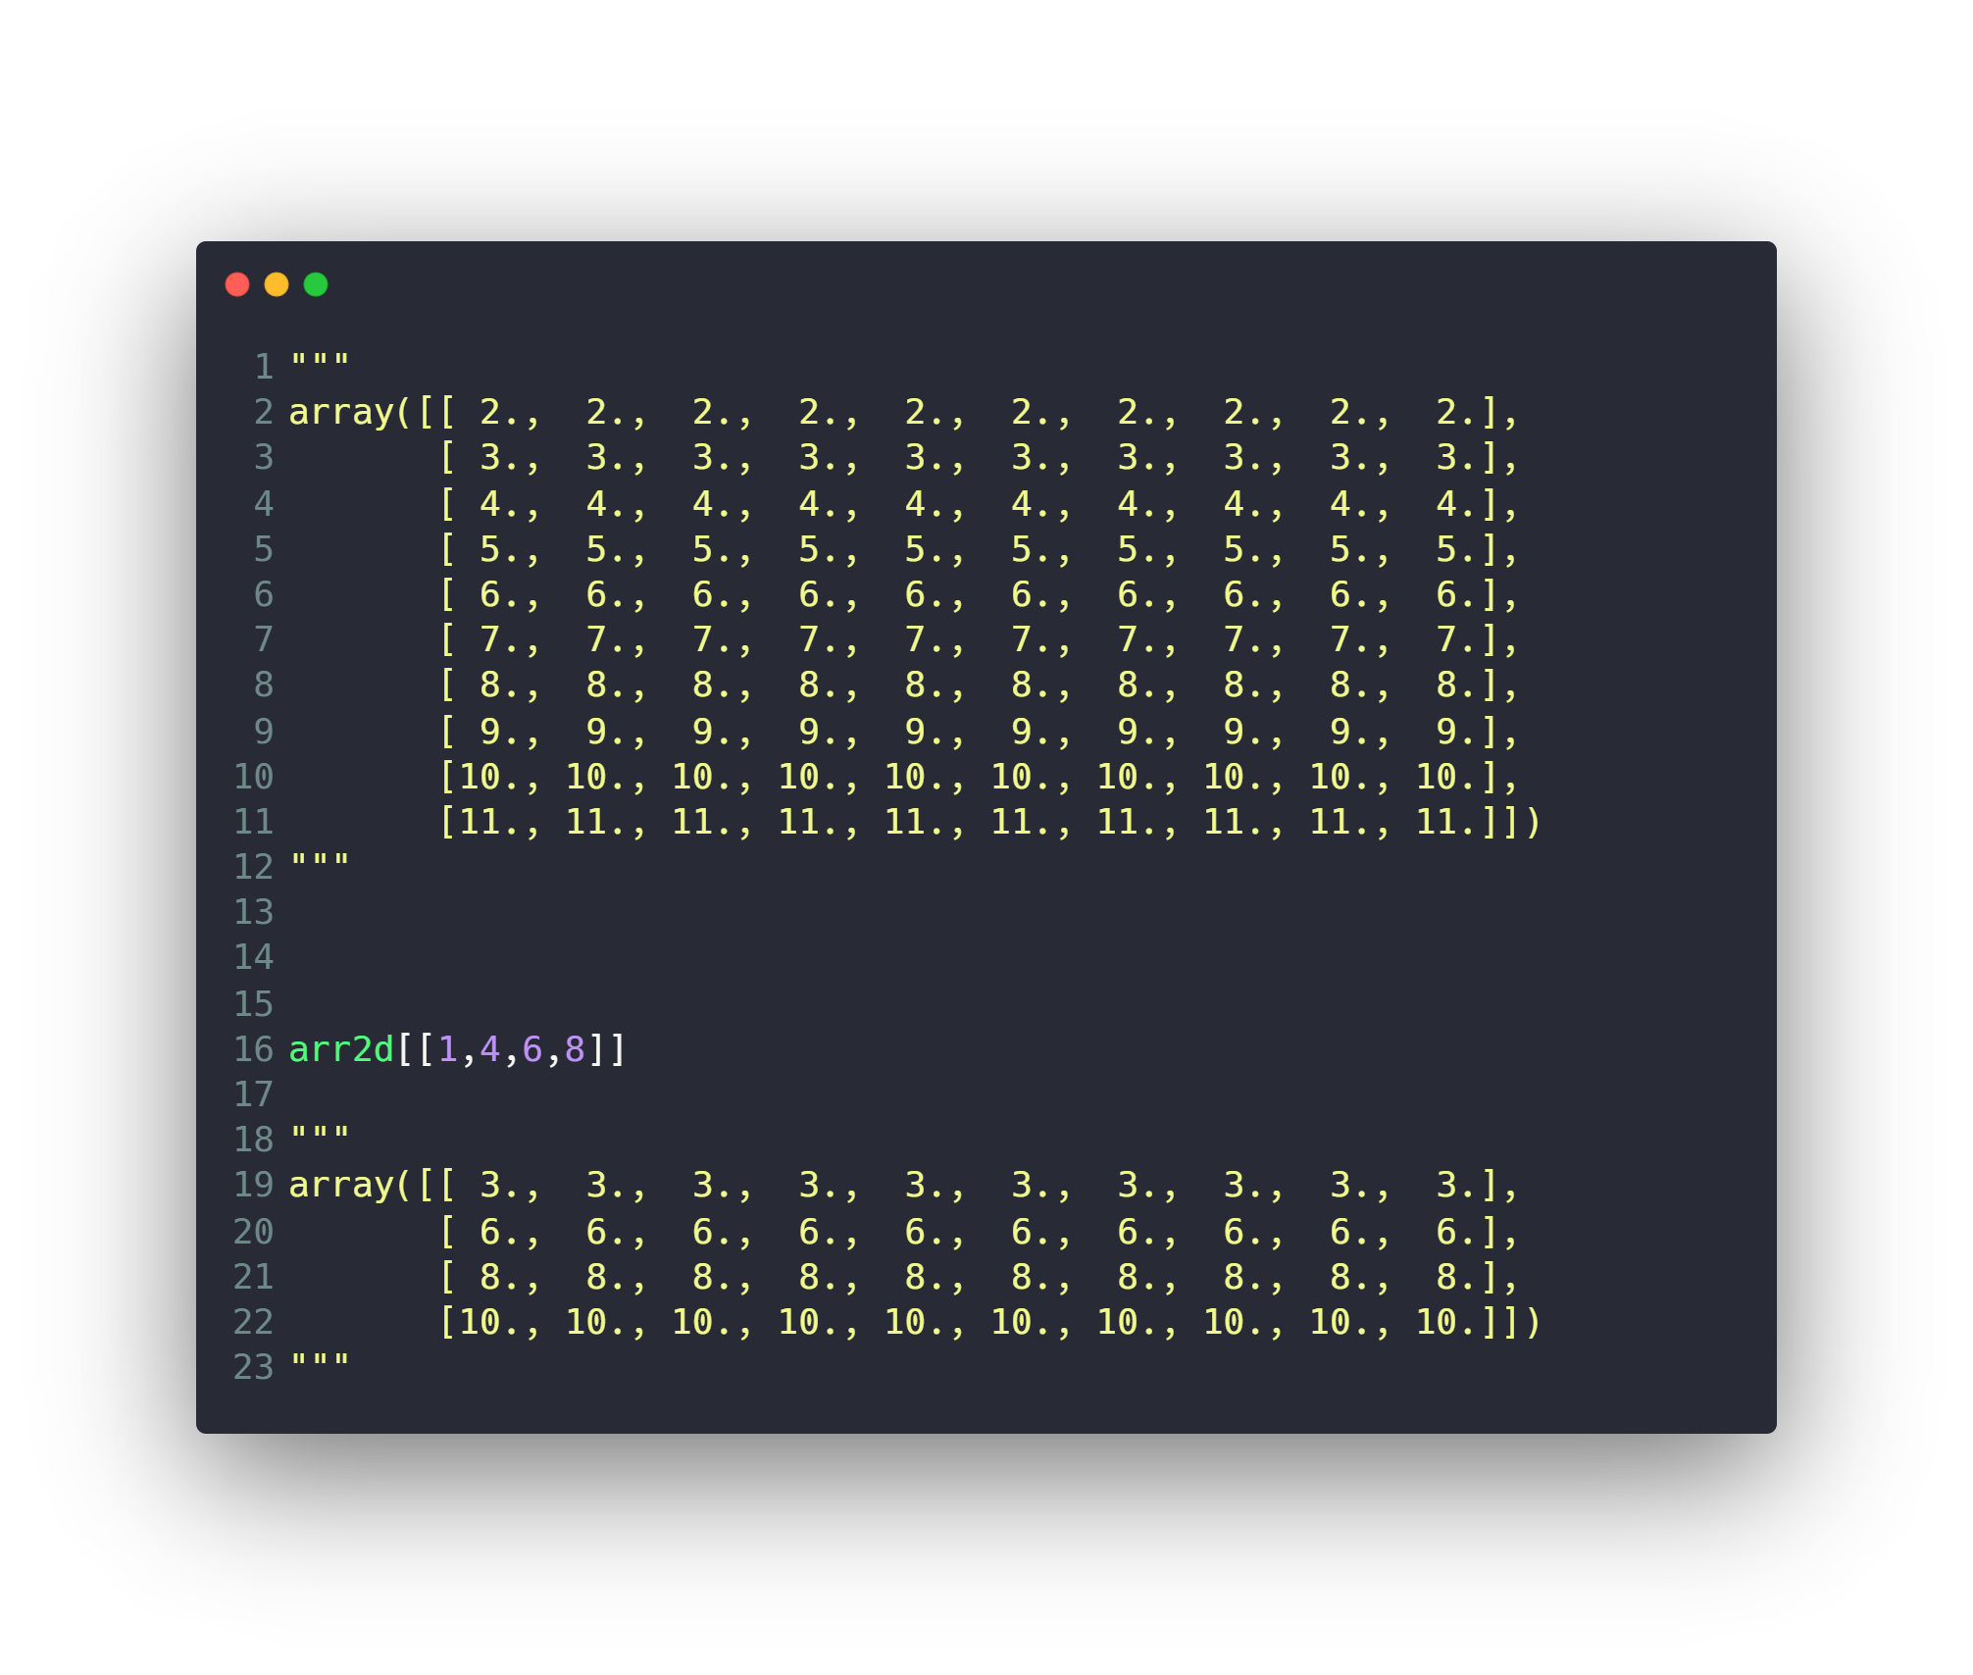
Indexing
Indexing 1D array
Indexing 2D array
Fancy Indexing

Slide 19
Agenda
What is Numpy
Install and use Numpy
Create Numpy Array
Built in Methods
Reshaping
Indexing
Selection
Arithmetic and Logic
Universal Array Functions
Combine and split
What is Pandas
Series
Data Frames
Deal with Missing data
Grouping data and aggregate functions
Merging, Joining and Concatenating
Pivoting
Useful Methods
Apply function
Data Input & Output

Slide 20
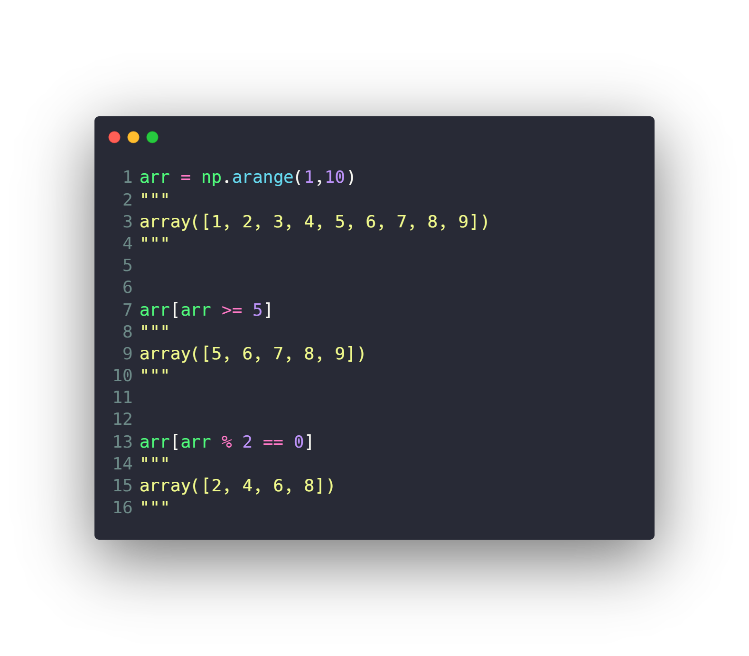
Selection

Slide 21
Agenda
What is Numpy
Install and use Numpy
Create Numpy Array
Built in Methods
Reshaping
Indexing
Selection
Arithmetic and Logic
Universal Array Functions
Combine and split
What is Pandas
Series
Data Frames
Deal with Missing data
Grouping data and aggregate functions
Merging, Joining and Concatenating
Pivoting
Useful Methods
Apply function
Data Input & Output

Slide 22
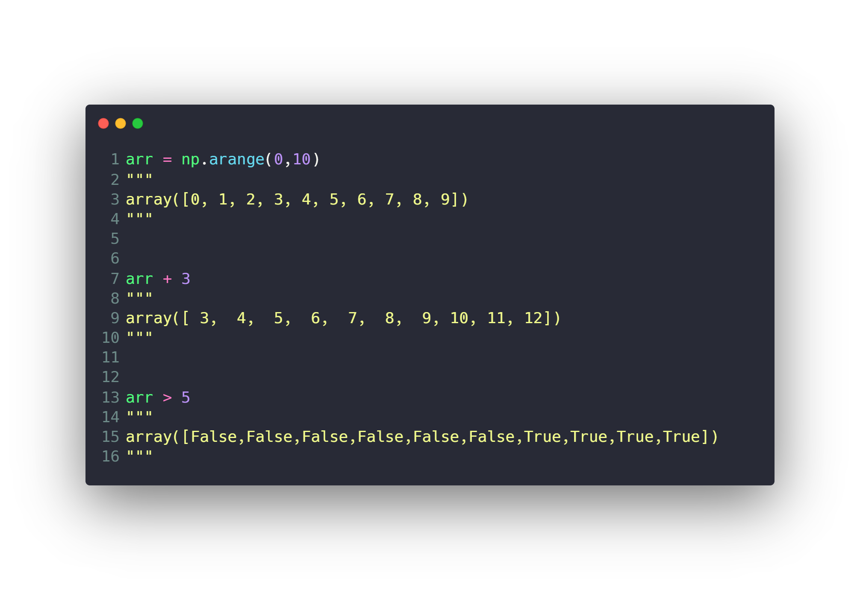
Arithmetic and Logic

Slide 23
Agenda
What is Numpy
Install and use Numpy
Create Numpy Array
Built in Methods
Reshaping
Indexing
Selection
Arithmetic and Logic
Universal Array Functions
Combine and split
What is Pandas
Series
Data Frames
Deal with Missing data
Grouping data and aggregate functions
Merging, Joining and Concatenating
Pivoting
Useful Methods
Apply function
Data Input & Output

Slide 24
Universal Array Functions
max
min
average
sum
power
sqrt
exp
log
sin
cos
tan
dot

Slide 25
Agenda
What is Numpy
Install and use Numpy
Create Numpy Array
Built in Methods
Reshaping
Indexing
Selection
Arithmetic and Logic
Universal Array Functions
Combine and split
What is Pandas
Series
Data Frames
Deal with Missing data
Grouping data and aggregate functions
Merging, Joining and Concatenating
Pivoting
Useful Methods
Apply function
Data Input & Output

Slide 26
Combine and split
hstack
vstack
concatenate
hsplit
vsplit

Slide 27
Agenda
What is Numpy
Install and use Numpy
Create Numpy Array
Built in Methods
Reshaping
Indexing
Selection
Arithmetic and Logic
Universal Array Functions
Combine and split
What is Pandas
Series
Data Frames
Deal with Missing data
Grouping data and aggregate functions
Merging, Joining and Concatenating
Pivoting
Useful Methods
Apply function
Data Input & Output

Slide 28
What is Pandas
Pandas is an open-source Python Library
used for high-performance data manipulation
and data analysis using its powerful data
structures.

Slide 29
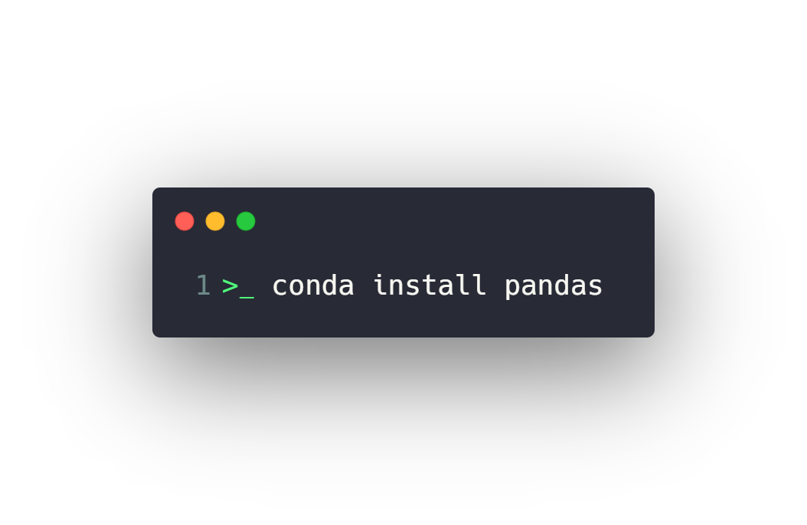
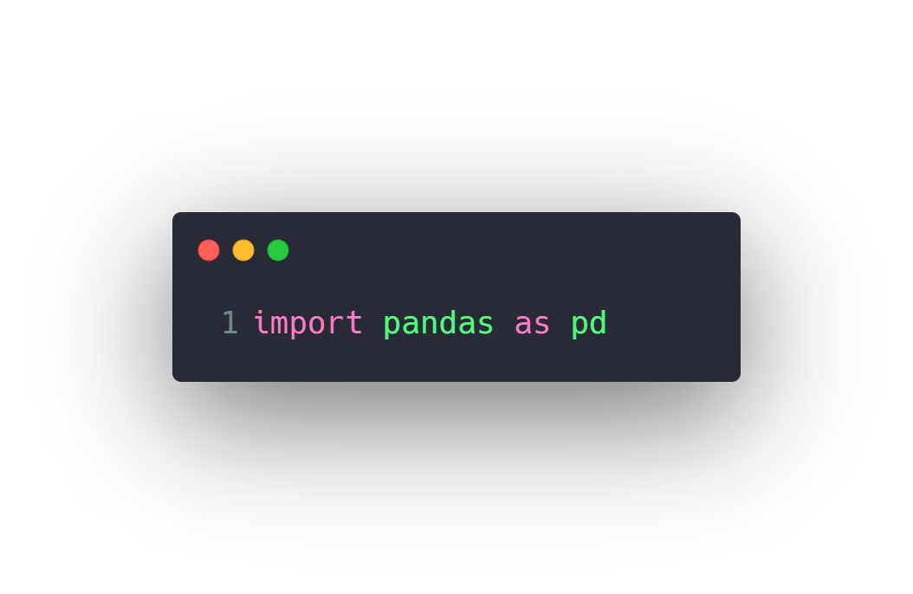
Install and use Pandas
Install
Use

Slide 30

What is Pandas
A python library used for Data Wrangling
Key Features
Fast and efficient Data Frame object with customized indexing.
Tools for loading from different file formats.
Data alignment and integrated handling of missing data.
Reshaping and pivoting of date sets.
Label-based slicing, indexing and subsetting of large data sets.
Columns from a data structure can be deleted or inserted.
Group by data for aggregation and transformations.
High performance merging and joining of data.
Time Series functionality.

Slide 31
Agenda
What is Numpy
Install and use Numpy
Create Numpy Array
Built in Methods
Reshaping
Indexing
Selection
Arithmetic and Logic
Universal Array Functions
Combine and split
What is Pandas
Series
Data Frames
Deal with Missing data
Grouping data and aggregate functions
Merging, Joining and Concatenating
Pivoting
Useful Methods
Apply function
Data Input & Output

Slide 32
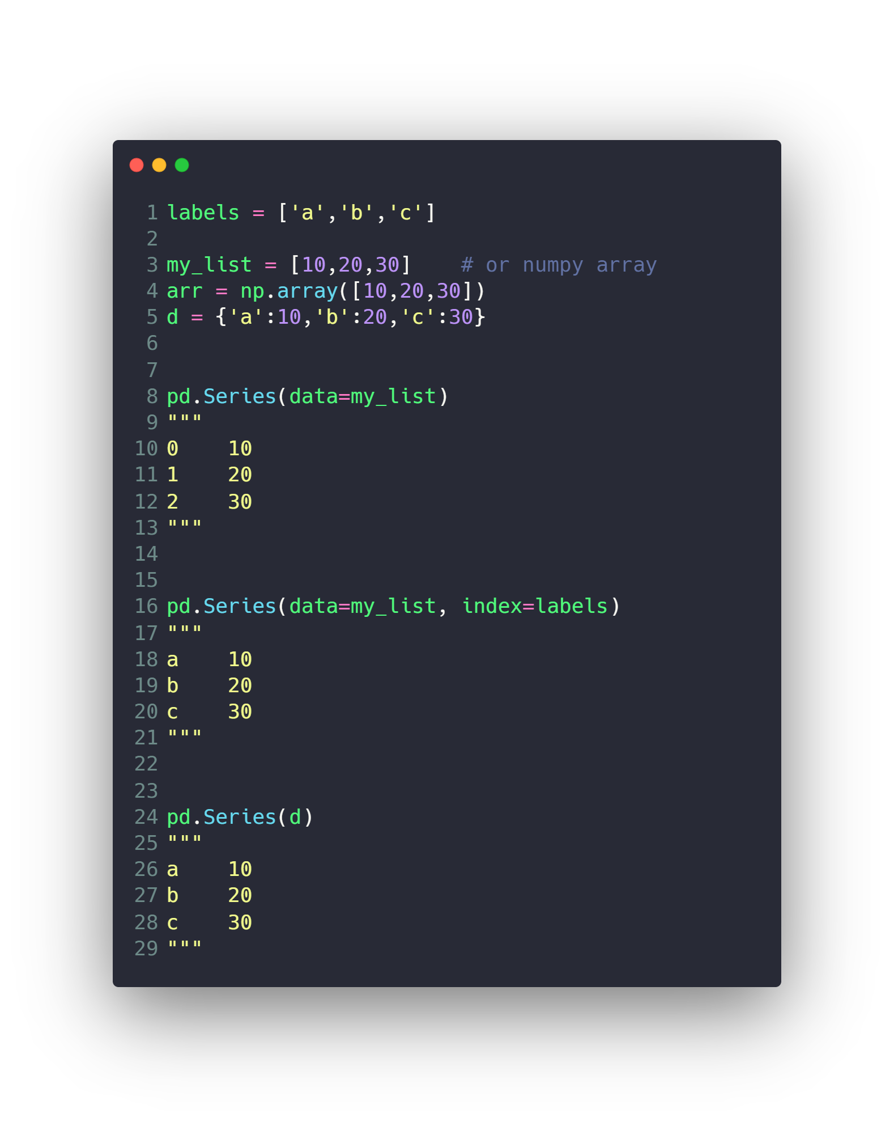
Series

Slide 33
Agenda
What is Numpy
Install and use Numpy
Create Numpy Array
Built in Methods
Reshaping
Indexing
Selection
Arithmetic and Logic
Universal Array Functions
Combine and split
What is Pandas
Series
Data Frames
Deal with Missing data
Grouping data and aggregate functions
Merging, Joining and Concatenating
Pivoting
Useful Methods
Apply function
Data Input & Output

Slide 34
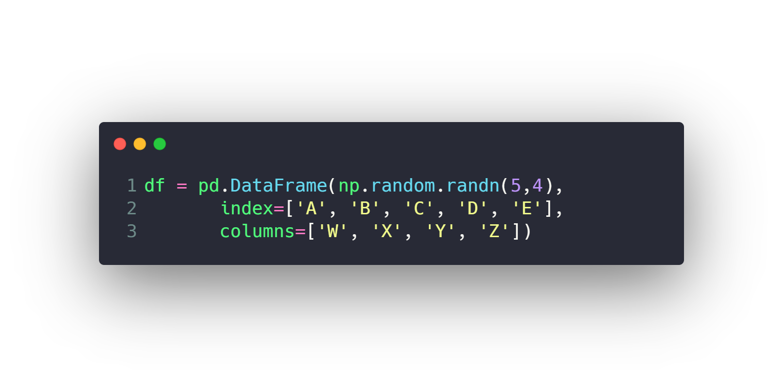
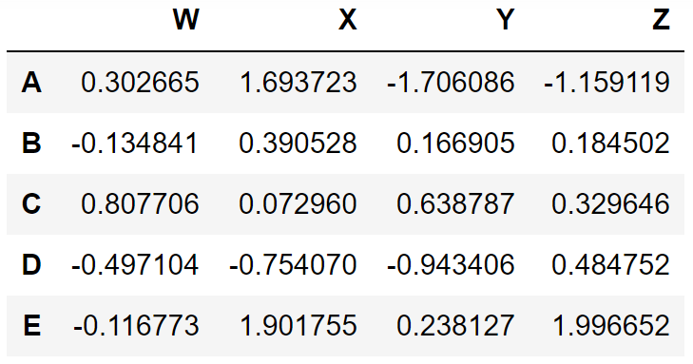
Data Frames

Slide 35
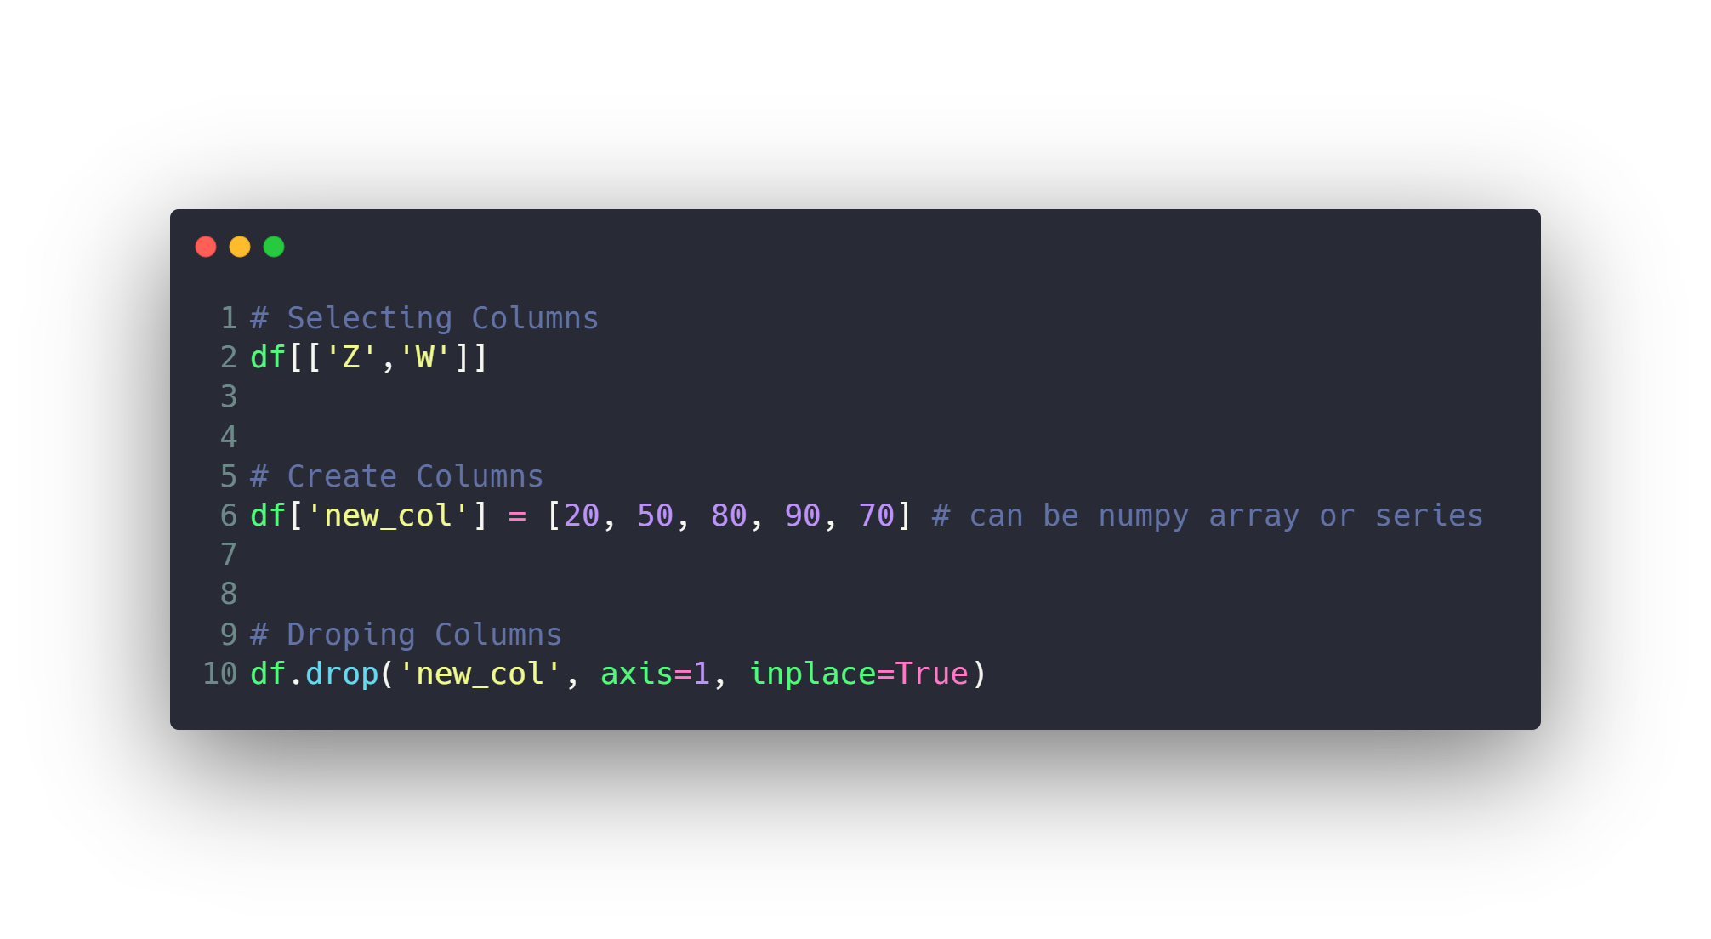
Data Frames
Selecting, Creating and Dropping Columns
Selecting, Creating and Dropping Rows
Selecting subset of rows and columns
Selecting by conditions
Selecting by data type
Set New Index & Reset Index

Slide 36
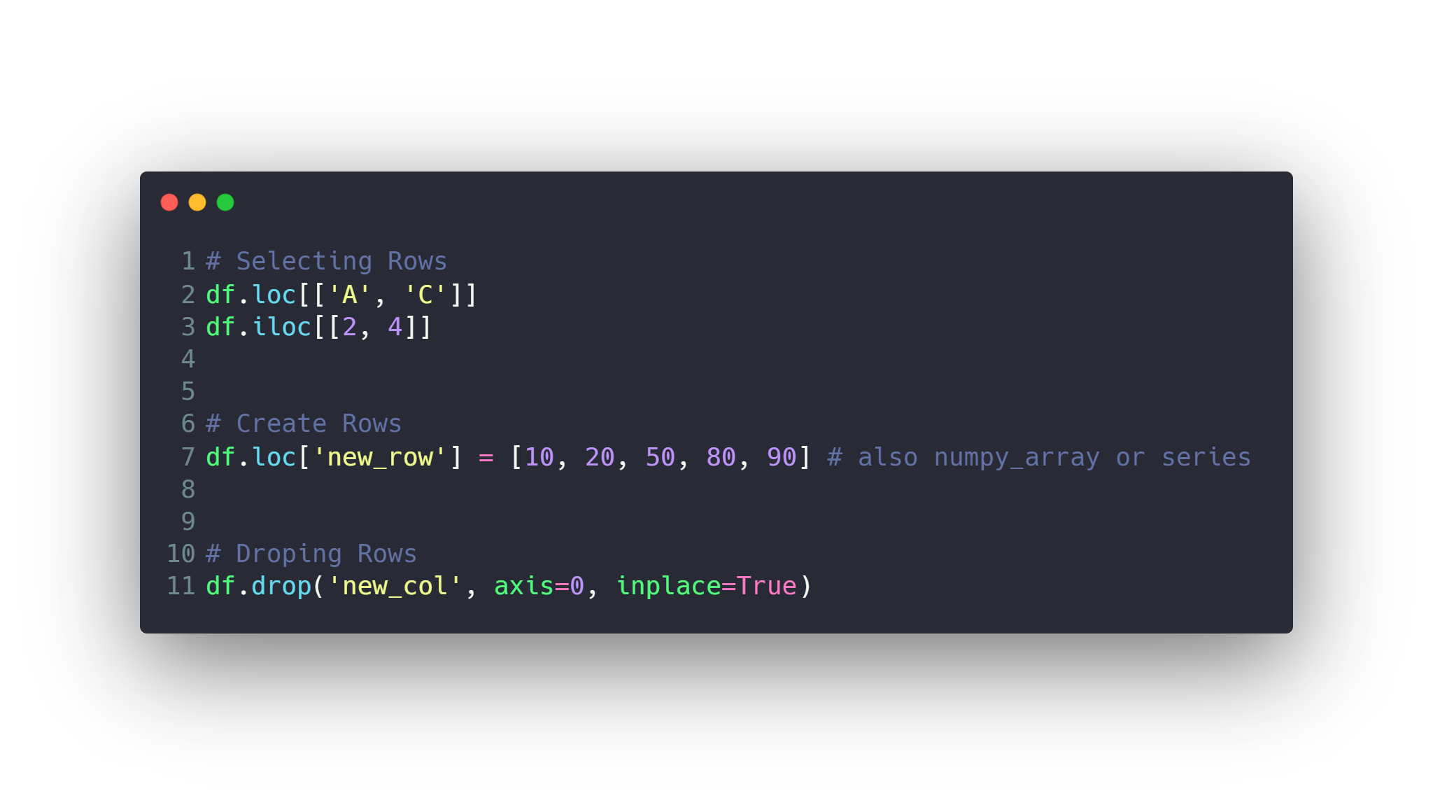
Data Frames
Selecting, Creating and Dropping Columns
Selecting, Creating and Dropping Rows
Selecting subset of rows and columns
Selecting by conditions
Selecting by data type
Set New Index & Reset Index

Slide 37
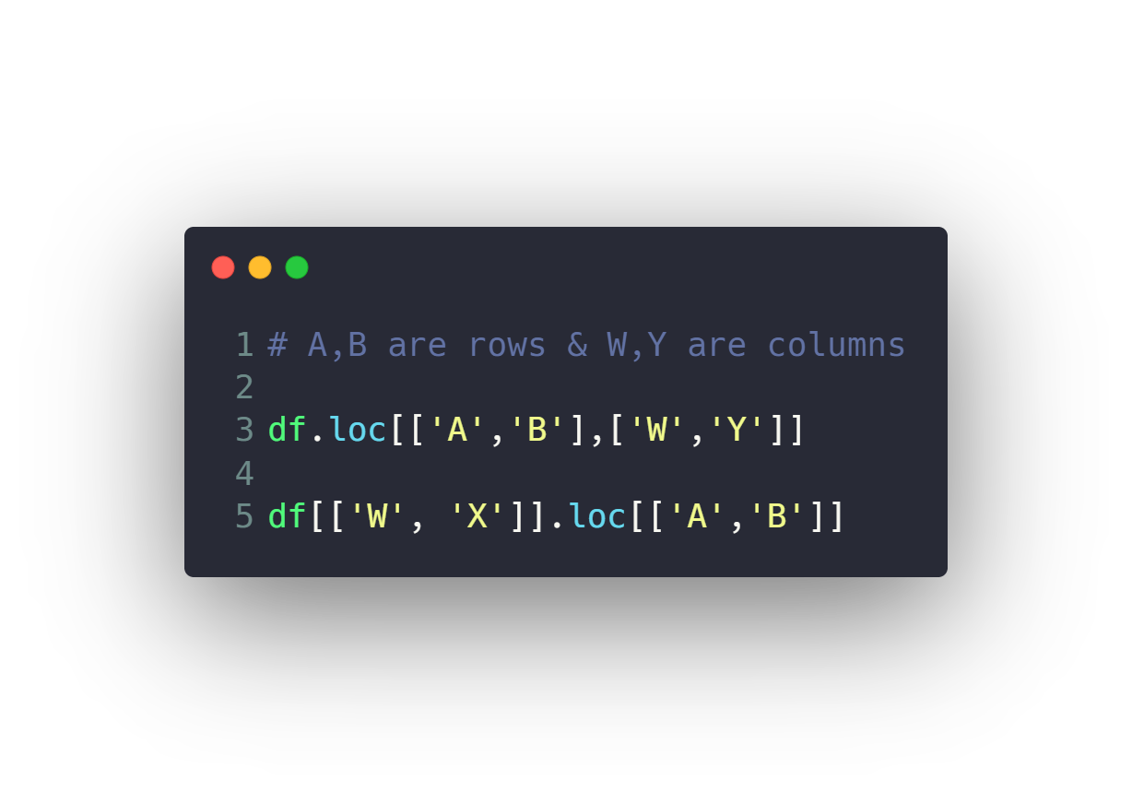
Data Frames
Selecting, Creating and Dropping Columns
Selecting, Creating and Dropping Rows
Selecting subset of rows and columns
Selecting by conditions
Selecting by data type
Set New Index & Reset Index

Slide 38
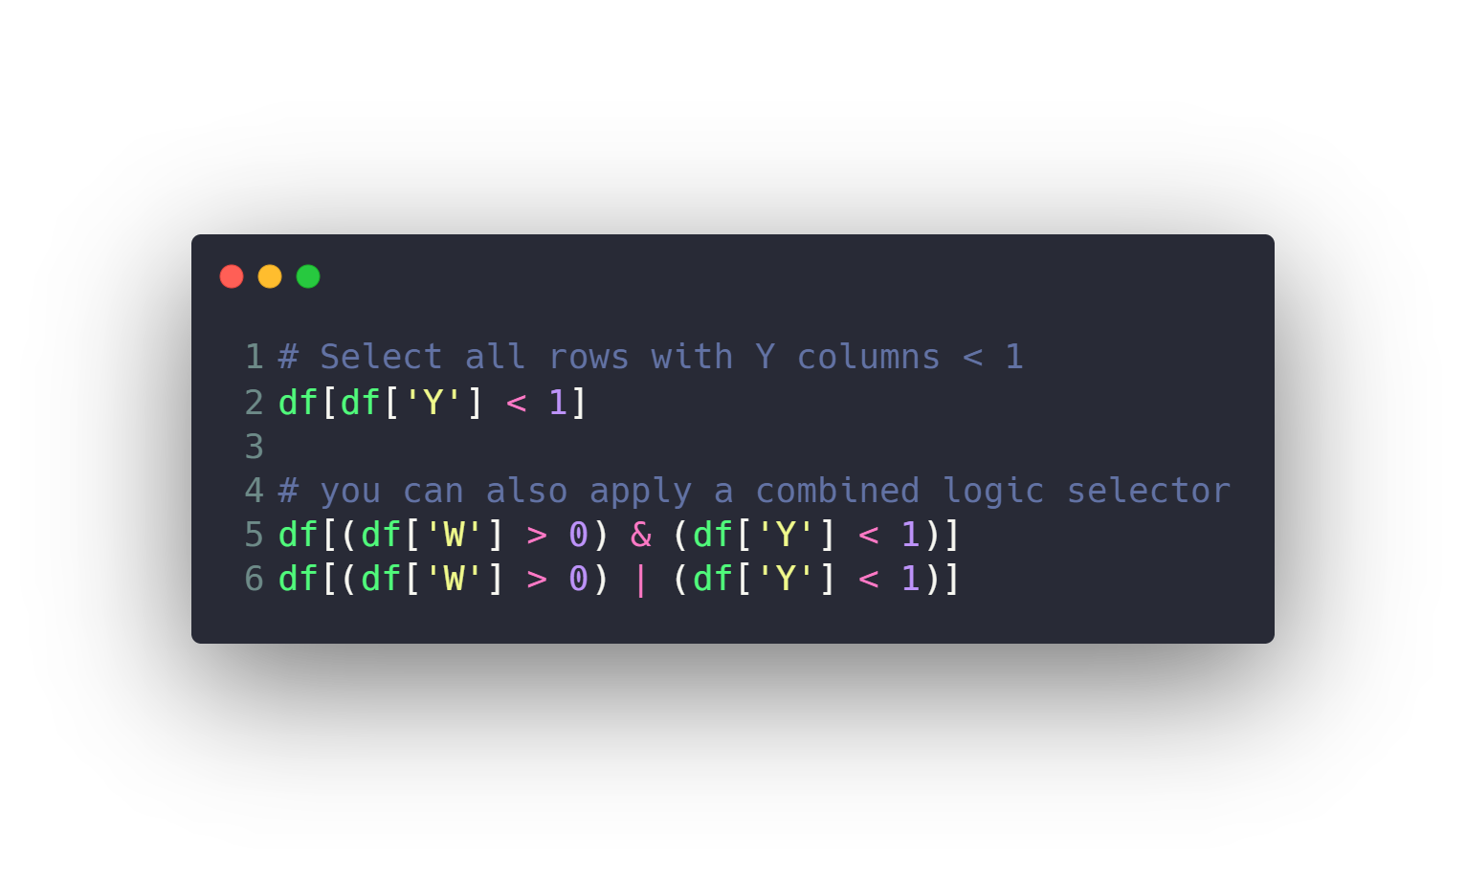
Data Frames
Selecting, Creating and Dropping Columns
Selecting, Creating and Dropping Rows
Selecting subset of rows and columns
Selecting by conditions
Selecting by data type
Set New Index & Reset Index

Slide 39
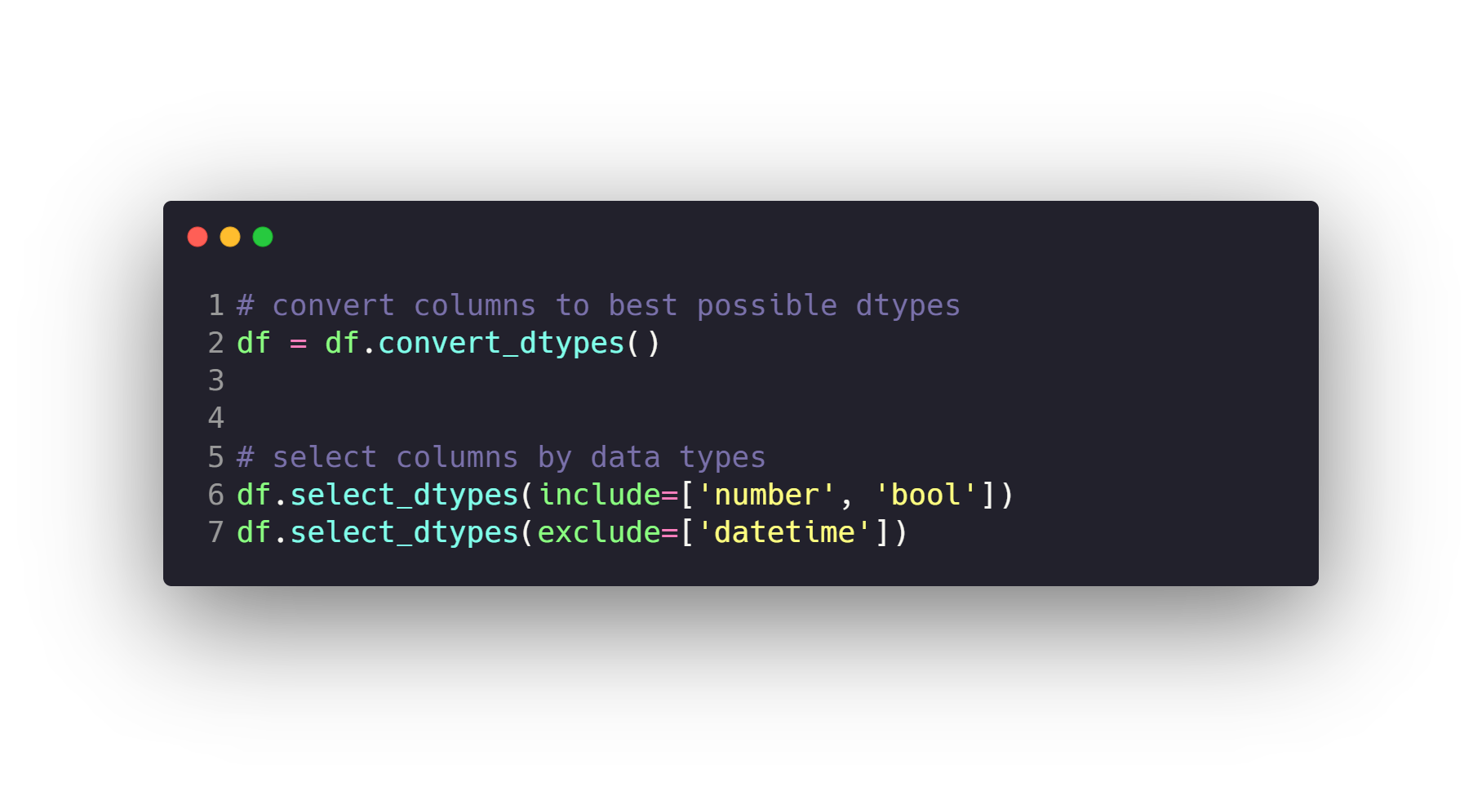
Data Frames
Selecting, Creating and Dropping Columns
Selecting, Creating and Dropping Rows
Selecting subset of rows and columns
Selecting by conditions
Selecting by data type
Set New Index & Reset Index

Slide 40
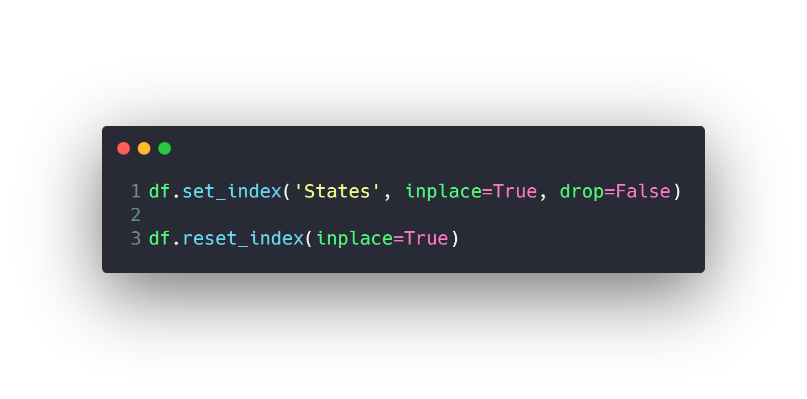
Data Frames
Selecting, Creating and Dropping Columns
Selecting, Creating and Dropping Rows
Selecting subset of rows and columns
Selecting by conditions
Selecting by data type
Set New Index & Reset Index

Slide 41
Agenda
What is Numpy
Install and use Numpy
Create Numpy Array
Built in Methods
Reshaping
Indexing
Selection
Arithmetic and Logic
Universal Array Functions
Combine and split
What is Pandas
Series
Data Frames
Deal with Missing data
Grouping data and aggregate functions
Merging, Joining and Concatenating
Pivoting
Useful Methods
Apply function
Data Input & Output

Slide 42
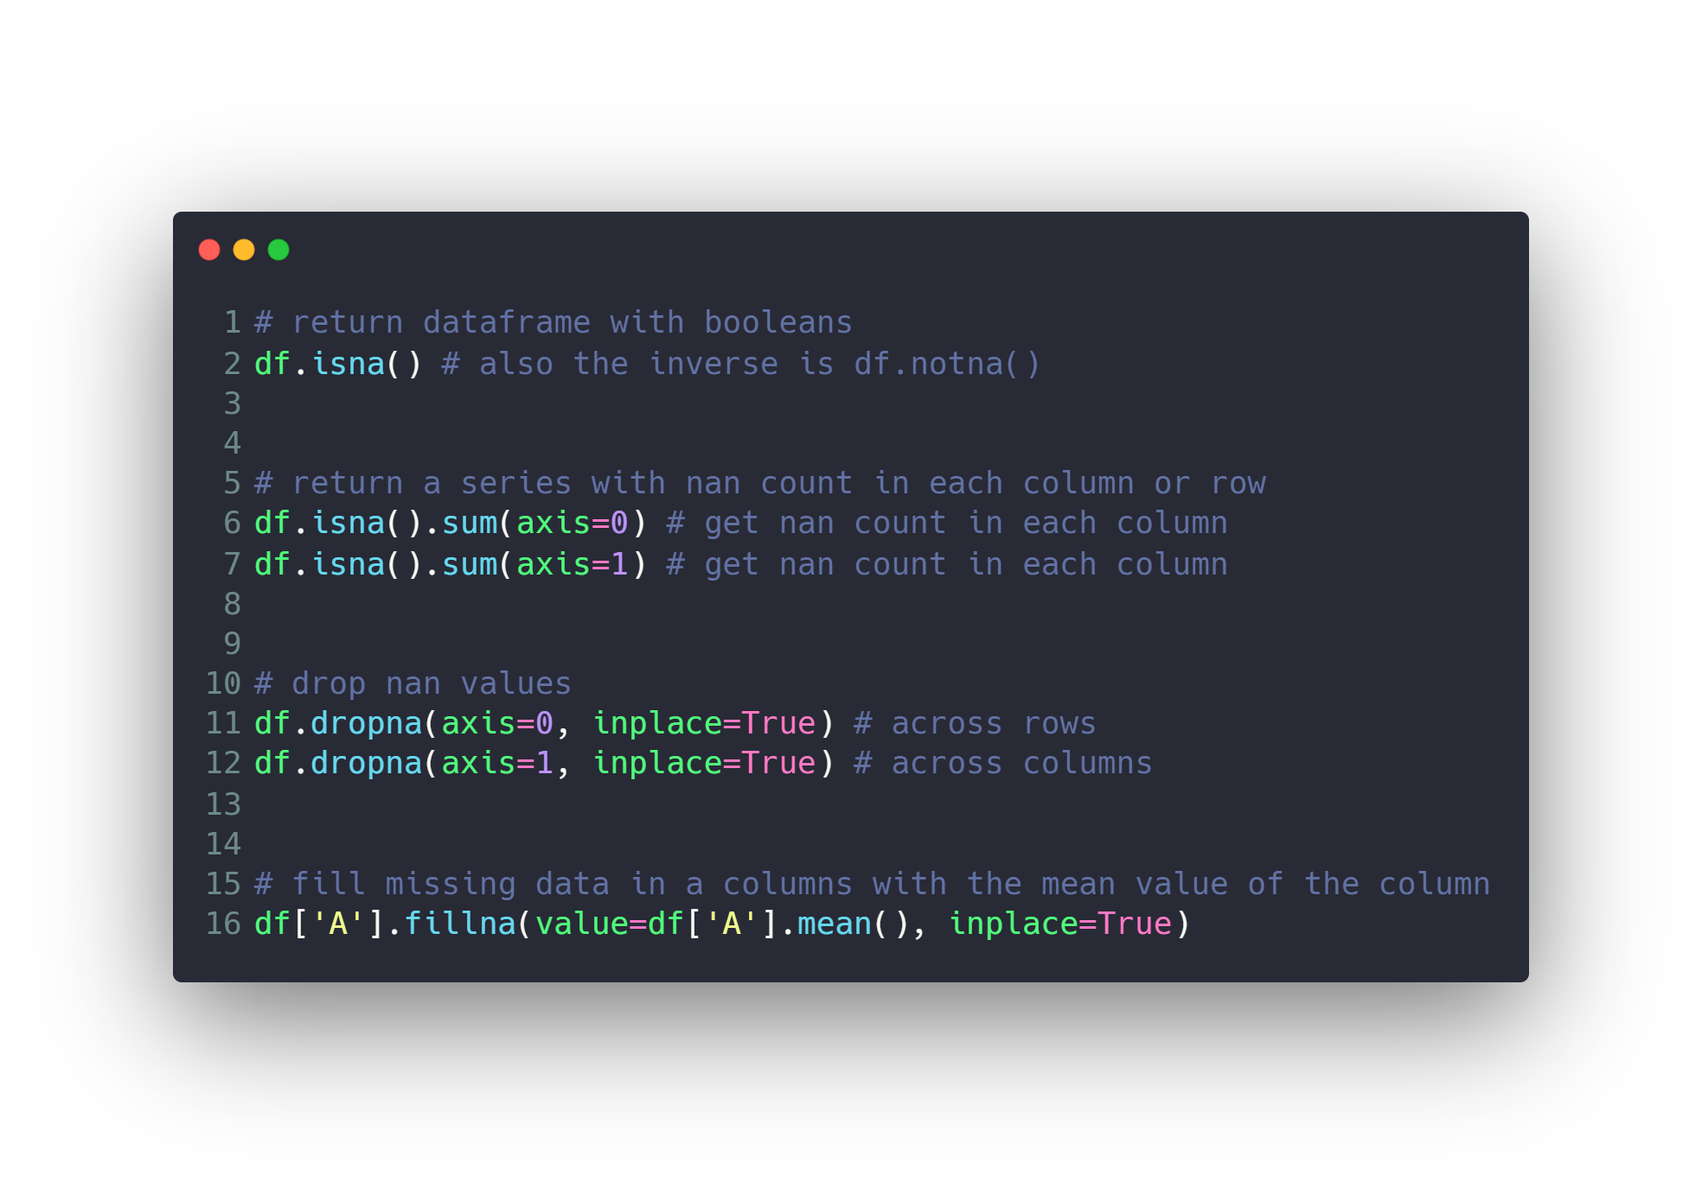
Deal with Missing data

Slide 43
Agenda
What is Numpy
Install and use Numpy
Create Numpy Array
Built in Methods
Reshaping
Indexing
Selection
Arithmetic and Logic
Universal Array Functions
Combine and split
What is Pandas
Series
Data Frames
Deal with Missing data
Grouping data and aggregate functions
Merging, Joining and Concatenating
Pivoting
Useful Methods
Apply function
Data Input & Output

Slide 44
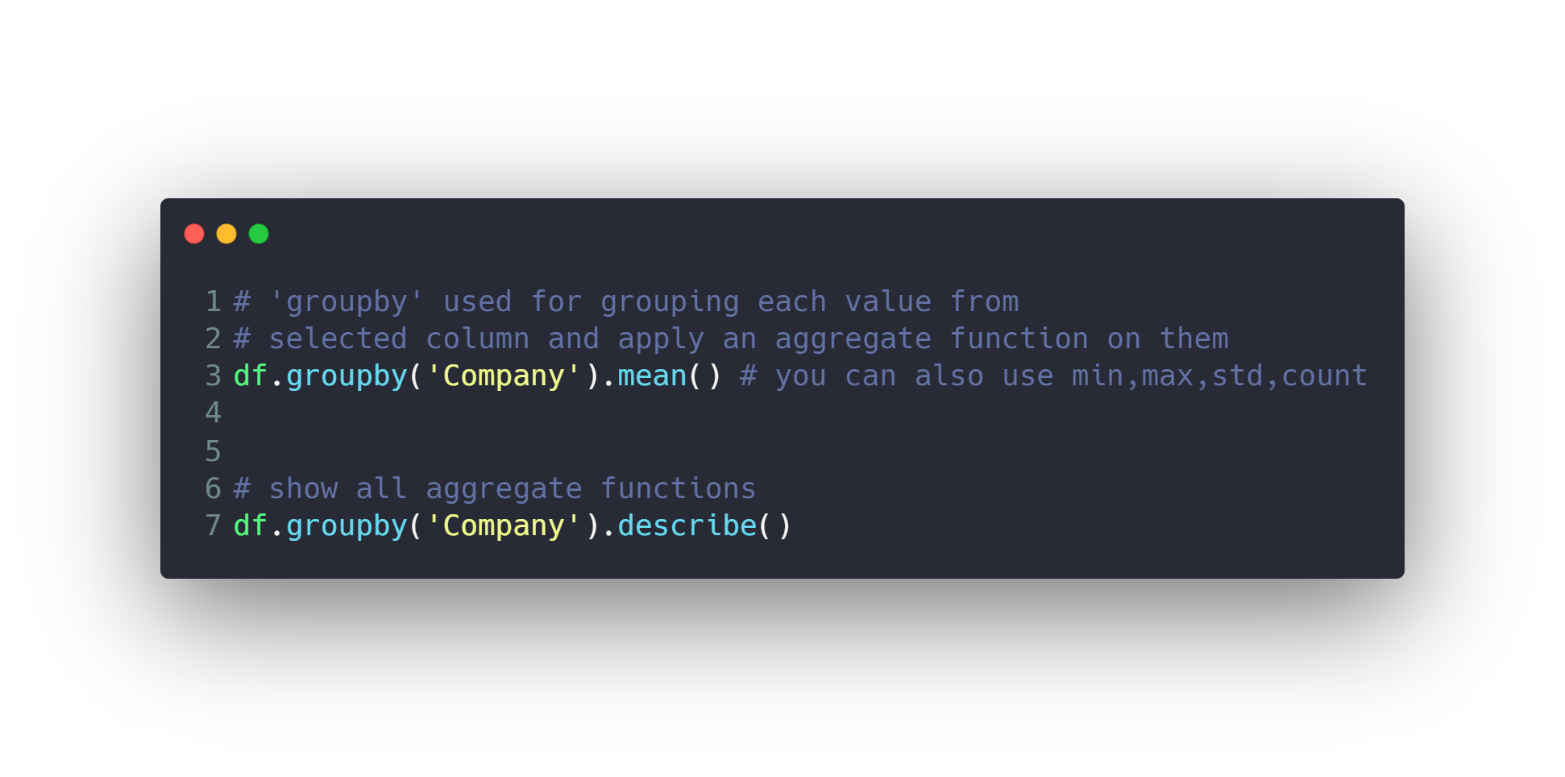
Grouping data and aggregate functions

Slide 45
Agenda
What is Numpy
Install and use Numpy
Create Numpy Array
Built in Methods
Reshaping
Indexing
Selection
Arithmetic and Logic
Universal Array Functions
Combine and split
What is Pandas
Series
Data Frames
Deal with Missing data
Grouping data and aggregate functions
Merging, Joining and Concatenating
Pivoting
Useful Methods
Apply function
Data Input & Output

Slide 46
Merging, Joining and Concatenating
Merging
Merging function allows you to merge DataFrames
together using a similar logic as merging SQL Tables
together
Joining
Joining is a convenient method for combining the columns of
two potentially differently-indexed Data Frames into a single
result Data Frame
Concatenating
Concatenation basically glues together DataFrames. Keep in
mind that dimensions should match along the axis you are
concatenating on

Slide 47
Agenda
What is Numpy
Install and use Numpy
Create Numpy Array
Built in Methods
Reshaping
Indexing
Selection
Arithmetic and Logic
Universal Array Functions
Combine and split
What is Pandas
Series
Data Frames
Deal with Missing data
Grouping data and aggregate functions
Merging, Joining and Concatenating
Pivoting
Useful Methods
Apply function
Data Input & Output

Slide 48
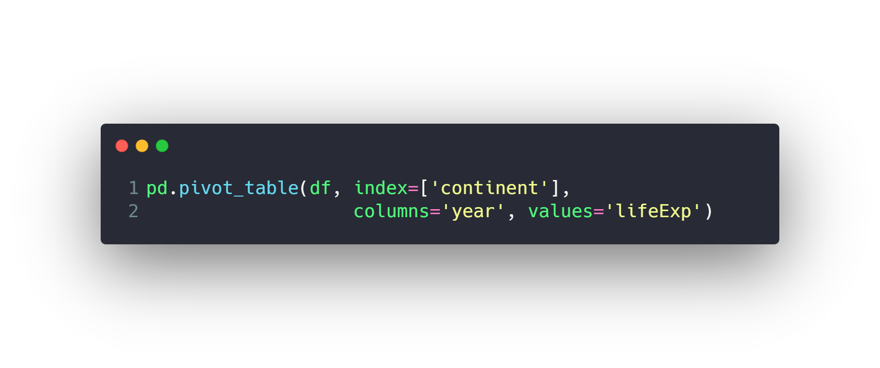
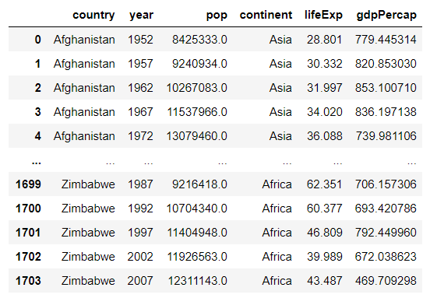
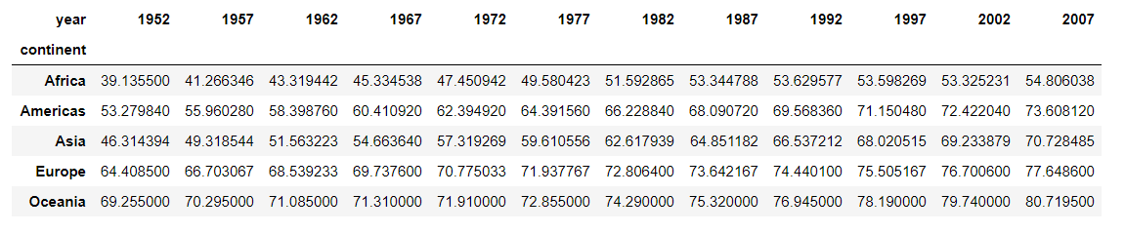
Pivoting

Slide 49
Agenda
What is Numpy
Install and use Numpy
Create Numpy Array
Built in Methods
Reshaping
Indexing
Selection
Arithmetic and Logic
Universal Array Functions
Combine and split
What is Pandas
Series
Data Frames
Deal with Missing data
Grouping data and aggregate functions
Merging, Joining and Concatenating
Pivoting
Useful Methods
Apply function
Data Input & Output

Slide 50
Useful Methods
unique
value_counts
sort_values
mean
median
mode
quantile
std
corr
min
max
sum
count
head
tail
info
describe
…

Slide 51
Agenda
What is Numpy
Install and use Numpy
Create Numpy Array
Built in Methods
Reshaping
Indexing
Selection
Arithmetic and Logic
Universal Array Functions
Combine and split
What is Pandas
Series
Data Frames
Deal with Missing data
Grouping data and aggregate functions
Merging, Joining and Concatenating
Pivoting
Useful Methods
Apply function
Data Input & Output

Slide 52
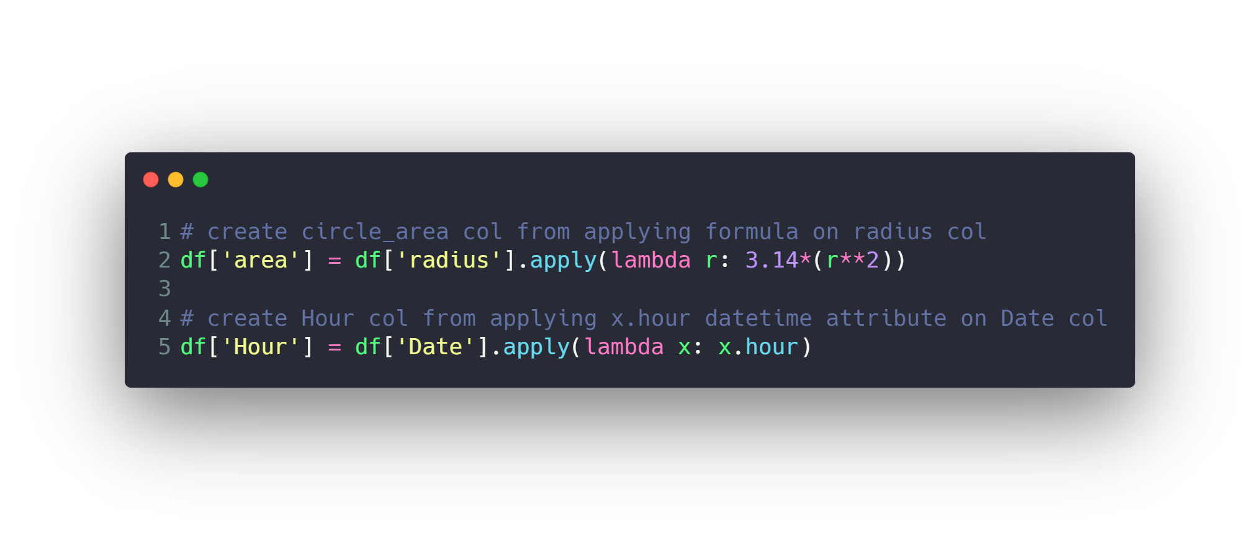
Apply function

Slide 53
Agenda
What is Numpy
Install and use Numpy
Create Numpy Array
Built in Methods
Reshaping
Indexing
Selection
Arithmetic and Logic
Universal Array Functions
Combine and split
What is Pandas
Series
Data Frames
Deal with Missing data
Grouping data and aggregate functions
Merging, Joining and Concatenating
Pivoting
Useful Methods
Apply function
Data Input & Output

Slide 54
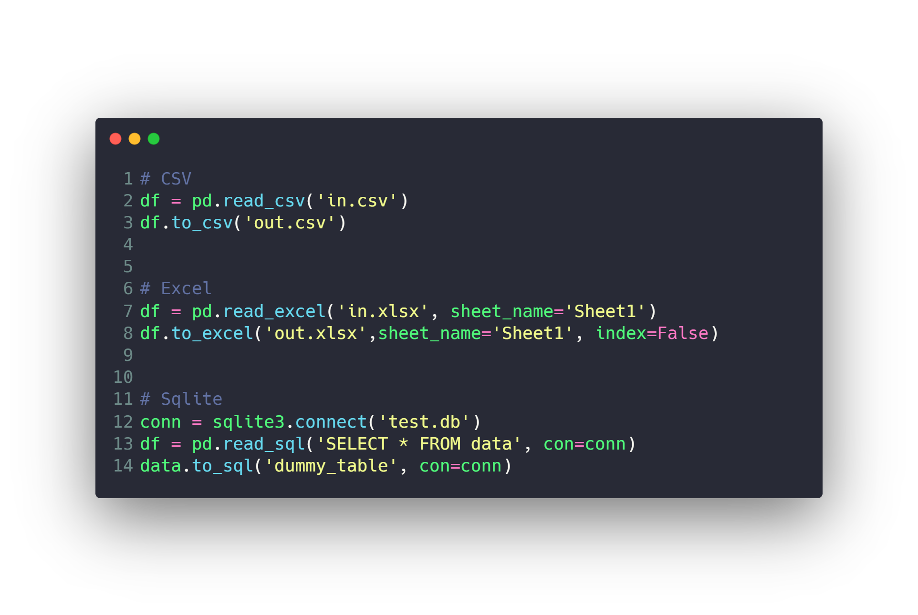
Data Input & Output

Slide 55
Questions ?!

Slide 56

Thanks! >_ Live long and prosper

